Slide 1
IMPORTANT INFORMATION BEFORE YOU BEGIN:
How to make this presentation your own:
Carefully review the contents of each slide as well as the speaker’s notes.
  There are a number of areas that you should customize based on the plan.
  These areas are either apparent on the slide itself or indicated in the speaker’s notes within brackets (“[customizable/variable content]”).
Use any slides in the “Plan highlights” section and beyond at your discretion, as these contain optional reference material, replacement slides, and supplemental plan information, as indicated.
Key considerations:
This presentation is designed to be completed within 20 minutes. Of course, the more content you cover, the longer the presentation will last.
The speaker’s notes can help you prepare for animation built into this presentation.
Please note: This presentation is provided as a template that you can customize with plan specific information, as appropriate. This presentation is provided solely for general educational and informational purposes. The information contained in this presentation is not intended and should not be construed as legal, tax, accounting, or investment advice. This information has been compiled from sources believed to be reliable, but the accuracy of the information is not guaranteed. The content and accuracy of such information is the responsibility of the source and not of Ascensus. Not all products, features, and services covered in the presentation are available to all plans. Any use of the presentation, in whole or in part, is done so at the user’s sole risk and should be used in accordance with your organization’s legal and compliance guidelines.
Notes:
[Review this information carefully.]
[Delete this slide before presenting.]

Slide 2

Join your retirement plan today!
Join your retirement plan today!
Presented by: Name(s)
<Financial partner and/or company logo (optional)>
This presentation may be presented by a Vanguard representative or a financial advisor partnering with Vanguard.
Notes:
[IMPORTANT INFORMATION BEFORE YOU BEGIN:
Please note: The information contained in this presentation has been compiled from sources believed to be reliable, but the accuracy of the information is not guaranteed. The content and accuracy of such information is the responsibility of the source and not of Vanguard. The presentation is provided solely for general educational and informational purposes. It is not intended and should not be construed as legal, tax, accounting, or investment advice. Not all products, features, and services covered in the presentation are available to all plans. Any use of the presentation, in whole or in part, is done so at the user’s sole risk.
Before giving this presentation, carefully review the contents of each slide as well as the speaker’s notes.
The speaker’s notes can help you prepare for the animation built into this presentation.
This presentation is designed to be completed within 20 minutes.]
We’re here to talk about your future.
Saving for retirement is about giving yourself choices. You’re helping yourself get in the best position to determine when you will stop working, how you will spend your time, and how comfortable you will be. The good news is that your employer has chosen a retirement plan that can help you prepare.

Slide 3
Planning made easy
Four questions you should ask yourself:
  Why save now?
  Why use your plan?
  How much is enough?
  What ways can you invest?
Notes:
To help you understand your options, we are going to keep it simple and focus on these four questions:
Why save now?
Why use your plan?
How much is enough?
What ways can you invest?
[click to go to the next slide]

Slide 4

Why save now?
Notes:
To help us start answering these questions, let’s look at a short video about why saving now is so important.
[click to play video – it will open in a new web browser window]
[click to go to the next slide]

Slide 5




Why save now?
Living expenses are on the rise.*
Look at how prices for everyday items have increased in the last 20 years.
2002 to 2022
$0.98
$2.71
$1.40
$5.06
$5.80
$9.16
$2.93
$5.79
* Source for eggs per dozen, gas per gallon, coffee per pound: Bureau of Labor Statistics; Source for movie ticket: National Association of Theater Owners.
*Source for eggs per dozen, gas per gallon, coffee per pound: Bureau of Labor Statistics; Source for movie ticket: National Association of Theatre Owners.
Notes:
And living expenses are on the rise.
The key is knowing how much you need and what it takes to achieve that goal.
[click to go to next slide]

Slide 6
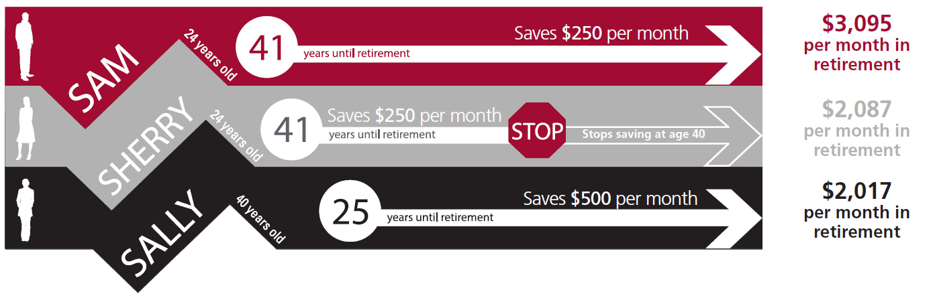
Put time on your side
Projected income
in retirement
[to age 90]
The illustrations above assume a retirement age of 65 and that the individual receives the monthly retirement payment shown until age 90. The amount saved until retirement assumes an annual investment return of 6%. The monthly payment amount in retirement assumes an annual investment return of 5%. The investment performance shown does not represent the return of any particular investment and does not guarantee any future rate of return.
The income in retirement does not reflect any taxes or penalties that may be due upon distribution. Withdrawals from a tax-deferred account before age 59½ are subject to a 10% federal penalty tax unless an exception applies.
6
Notes:
Time makes all the difference
No matter what point you are at in your life, starting to save now is usually better than starting to save later.
Consider this scenario:
Sam starts saving early and keeps saving for the long term.
Sherry starts saving early, but only saves for 16 years before stopping.
Sally starts saving later, but saves double what Sam and Sherry save per year.
Who do you think comes out ahead in the end?
[click]
The results:
Sam saves the most with more than $1,000 additional income per month in retirement.
Sherry and Sally are neck-and-neck, although Sally contributed much more money to the account.
There is a cost to delaying saving. Put time on your side and let your money work for you.
[click to go to next slide]
[For reference:
Retirement Income Criteria:
The illustrations above assume a retirement age of 65 and that the individual receives the monthly retirement payment shown until age 90. The amount saved until retirement assumes an annual investment return of 6%. The monthly payment amount in retirement assumes an annual investment return of 5%. The investment performance shown does not represent the return of any particular
investment and does not guarantee any future rate of return. The income in retirement does not reflect any taxes or penalties that may be due upon distribution. Withdrawals from a tax-deferred
account before age 59½ are subject to a 10% federal penalty tax unless an exception applies.

Slide 7
Why use your plan?
Convenience
  Automatic payroll deductions will be deposited directly in your account.
Ownership
  Your contributions and earnings belong to you.
Pretax savings advantages
  Your money is invested before taxes and you won’t need to pay tax on it until it’s withdrawn.
Notes:
The good news: Your retirement plan provides a great way to save with many advantages.
Convenience
Automatic payroll deductions make saving second nature.
Ownership
The money you contribute and any earnings belong to you.
Take it with you throughout your career and every phase of life to use in retirement.
Tax advantages
Your money is invested before taxes – which has two important benefits.
[click to go to the next slide]

Slide 8
Why use your plan?
Pretax savings advantages
The impact on your paycheck may be less than the amount you contribute due to the plan’s tax advantages.
  .
Savings rate: | 12% | 10% | 8% | 6%
Value of your contribution | $250.00 | $208.33 | $166.67 | $125.00
Actual deduction from your pay | $200.00 | $166.67 | $133.33 | $100.00
Assumes annual compensation of $50,000 paid at a bi-weekly frequency. This illustrative deduction from your pay assumes a hypothetical 20% federal tax rate and (i) may not reflect the federal tax rate currently in use; and (ii) does not consider the impact of state and local taxes or the actual rate that you may pay. To determine your federal tax rate, visit www.irs.gov or consult your tax advisor. The IRS limits the maximum contribution you can save from your pay in 2023 to $22,500. Once you reach this limit for the year, you will not be able to make further contributions for the remainder of the year and may miss out on further employer matching contributions. This illustration assumes you make equal contributions each pay period throughout the year.
Notes:
Pretax savings means that:
Every dollar you contribute reduces your paycheck by less than a dollar.
Your contributions are not taxable in the year you make them – which can reduce your tax bill.
[click to go to the next slide]

Slide 9
Why use your plan?
OPTIONAL SLIDE
Delete this box if using this slide OR
Delete entire slide if not applicable to plan.
Consider a different type
of tax advantage: Roth
This feature allows you to pay taxes upfront so you can make tax-free withdrawals later.
Even earnings are tax-free when certain withdrawal requirements are met.
Withdrawals from a Roth 401(k) are tax free if you are over age 59½ and have held the account for at least five years. If you take a withdrawal from your Roth 401(k) account before age 59½ and less than five years, a portion of the withdrawal may be subject to ordinary income tax or a 10% federal penalty tax, or both. (A separate five-year period applies for each conversion and begins on the first day of the year in which the contribution is made.)
What about Roth?
Notes:
[Keep this slide only if plan has a Roth feature.]
The Roth feature typically is considered to be beneficial in the long term if you are a younger investor and/or if you think your income taxes will be higher at the time of your retirement.
[click to go to next slide]

Slide 10
Why use your plan?
OPTIONAL SLIDE
Delete this box if using this slide OR
Delete entire slide if not applicable to plan.
Don’t leave money on the table.
Your employer wants to see you succeed and is willing to help you along the way with additional employer contributions.
Give your savings a boost
Notes:
[Keep this slide only if plan has match or profit sharing. Update content in pop-up accordingly.]
Best of all, your plan offers a match/profit sharing.
[click to go to next slide]

Slide 11
How much is enough?
Experts recommend saving at least
10-15%
*
If you have to, start small and make gradual increases each year. Remember, every bit counts.
Need help? Visit Vanguard’s resource center at
vanguard.com/resourcecenter
*CNN Money, Ultimate Guide To Retirement, bit.ly/ret-save-amt, accessed August 2021.
Notes:
Raise your hand if you know exactly the right amount to save…
If you don’t have your hand raised, don’t worry – you’re not alone.
[click]
Many people underestimate how much they need to save. Saving enough can help you maintain the lifestyle you desire.
Most experts recommend saving anywhere from 10 to 15 percent of your income.
If you aren’t quite at that point, consider contributing as much as possible and increasing the amount each year.
[If applicable, suggest that, at the very minimum, they should consider contributing enough to reach the company match.]
If you need additional assistance, use Vanguard’s savings calculator and tools to help you determine how much you can save.
[click to go to the next slide]

Slide 12





How much is enough?
Create opportunities to save
Pack a lunch.¹
Monthly savings = $120
Drop cable for online streaming.²
Monthly savings =
$50
Carpool to work.³
Monthly savings =
$60
Be a discount shopper.⁴
Monthly savings =
$40
¹ Based on purchasing lunch 20 times a month at $10.00 per meal versus packing a $4.00 lunch.
² Based on paying $50 a month for internet and $30 a month for Sling TV versus $130 a month for internet and cable: https://cordcutting.com/cord-cutting-calculator.
³ Assumes a commute of 15 miles (each way), 5 days a week, in a vehicle getting 25.4 mpg, and an average gas price of $5.06. Source for average vehicle mpg: Environmental Protection Agency, EPA Highlights of CO2 and Fuel Economy Trends, http://bit.ly/avg-mpg (preliminary number for 2020 model year). Source for average gas price: Bureau of Labor Statistics, accessed August 2022.
⁴ Based on using a 20% coupon for a purchase of $200 or greater.
Notes:
Getting there is possible: Prioritize retirement. Make saving a habit. And seek out ways to boost your savings.
[click to go to the next slide]

Slide 13
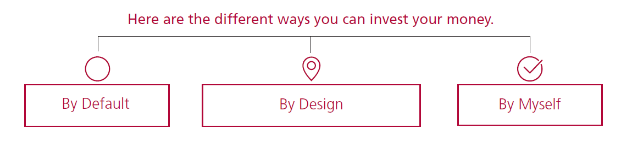
What ways can you invest?
13
Notes:
Understanding the investments available to you can help you find a suitable approach to keep your savings strategy on target.
[click]
You can choose the path that best fits your individual scenario and financial goals.
By Default: Enroll in the plan, but don’t make any investment elections.
By Design: Choose from an investment mix that is based on certain established criteria, such as retirement age and risk tolerance.
By Myself: Create your own investment mix from the options offered in your plan.
[click to go to next slide]

Slide 14
Investment selection
Your plan offers investment options that provide a way to get in the plan and begin saving now.
However, if you complete the enrollment process, but do not make any investment elections, your savings will be invested in the plan’s default investment.
Get a personalized retirement strategy using Morningstar's Retirement Manager at my.vanguardplan.com.
Investment advice generated by Morningstar® Retirement ManagerSM is based on information provided and limited to the investment options available in the defined contribution plan. Projections and other information regarding the likelihood of various retirement income and/or investment outcomes are hypothetical in nature, do not reflect actual results, and are not guarantees of future results. Results may vary with each use and over time. Morningstar Investment Management and its affiliates are not affiliated with Ascensus, LLC.
All investing is subject to risk, including the possible loss of the money you invest.
Notes:
If you complete the enrollment process, but do nothing else, your savings will be invested in the plan’s default investment.
[You can identify the plan’s default investment.]
Once you’ve enrolled, you can also build a personalized investment strategy using Morningstar® Retirement ManagerSM, a web-based resource. When you provide basic information about your situation and goals, the experts at Morningstar Associates, LLC, can generate a personalized investment strategy.
[Discuss the options for plan, including whether plan offers Morningstar’s fee-based managed account solution.]
[click to go the next slide]

Slide 15




Investment selection
Your plan offers high-quality investments to create a custom mix.
  Online fund information and resources allow you to make the best choices for your personal situation.
  The online learning center provides easy access to educational guides, relevant financial articles, and tools.
Use these online tools to help you plan
Calculators
Investment info
Performance history
Market update
Notes:
For those of you who like to chart your own path, your plan offers resources to help you make your own investment decisions.
[click]
Use these online tools to help you plan.
[click to go to next slide]

Slide 16
Target date retirement funds
Target Date Retirement Fund Video

Slide 17
Join now!
Enroll in the plan.
  Online: my.vanguardplan.com
  Phone: 866-794-2145
Stay informed.
  Go online to access account details, fund information, education, relevant financial articles, and tools.
Update your strategy.
  Review and update your strategy at least once a year.
Notes:
So, hopefully by now you’ve made the decision that you want to save for your future — What’s next?
Enroll in the plan.
Getting started is easy.
[Direct them to the web, phone or form as appropriate.]
Remember, while enrolling is an essential part of saving, it doesn’t stop there. There are other key steps to helping you become retirement ready.
Stay informed.
Update your strategy.
This is particularly important if you experience a major life event.
Register online today to access a wide range of planning resources designed to help you succeed.
[click to go the next slide]

Slide 18
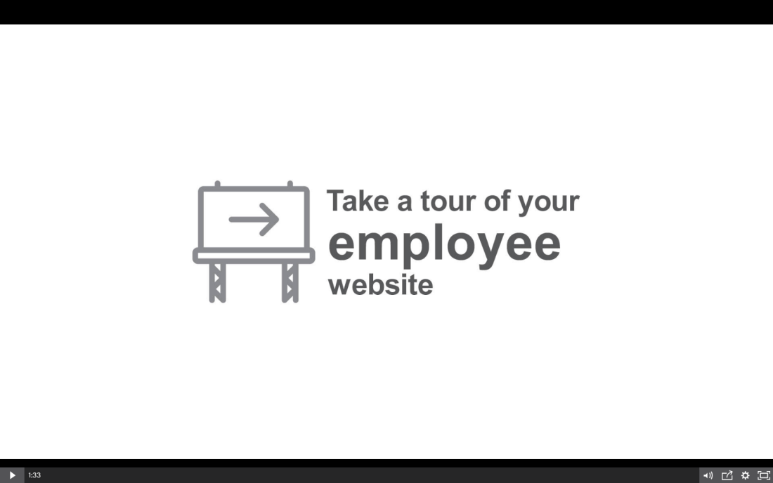
Guided tour of the website
Demo of how to enroll in the plan
Demo of our retirement calculator
The most important step to saving
for your future is…starting.
Join the plan
Notes:
[Click the image to conduct a demo of the website – it will open in a new window.]
[click to go to the next slide]

Slide 19
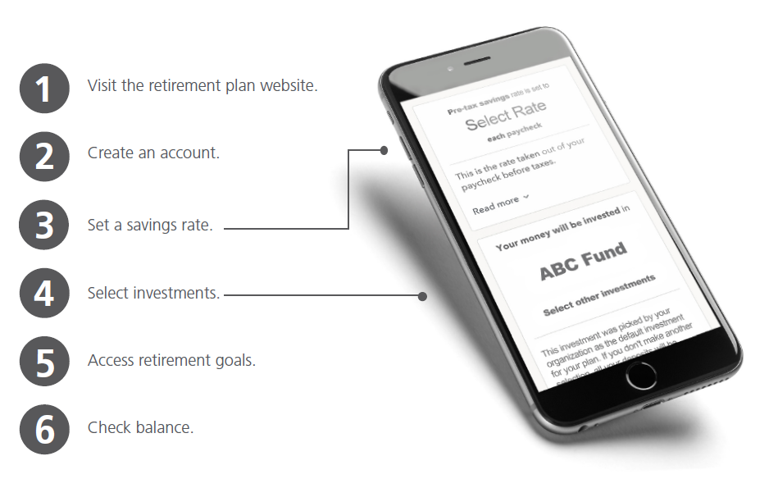
Ready to get started?
You have the ability to register, enroll, and track your progress right from your mobile phone.
You have the ability to register, enroll, and track your progress right from your mobile phone.
Notes:
[DELETE THIS SLIDE IF YOUR PLAN DOES NOT HAVE MOBILE ENROLLMENT]
So, to show you just how easy it is to enroll – take out your smartphone.
[Give mobile web address and show them how to access the site.]
First, let’s visit the retirement plan website and create an account.
Then, you can set your savings rate and select investments.
After you are set, you can use this site to access your retirement goals and check your balance.

Slide 20

This is your opportunity.
The decision to save today can shape your
future. You’ll thank yourself later.
Join the plan.
This presentation was created for educational and informational purposes only and is not intended as ERISA, tax, legal or investment advice. If you are seeking investment advice specific to your needs, such advice services must be obtained on your own separate from this educational presentation.
For more information about any fund, including investment objectives, risks, charges, and expenses, call Vanguard at 800-523-1188 to obtain a prospectus or, if available, a summary prospectus. The prospectus contains this and other important information about the fund. Read and consider the prospectus information carefully before you invest. You can also download Vanguard fund prospectuses at vanguard.com.
Vanguard Marketing Corporation (“VMC”) is the distributor of the Vanguard Funds and a subsidiary of The Vanguard Group, Inc. VMC is a registered broker-dealer, member FINRA and SIPC. Retirement plan recordkeeping and administrative services are provided by The Vanguard Group, Inc. (“VGI”). VGI has entered into an agreement with Ascensus, LLC to provide certain plan recordkeeping and administrative services on its behalf. Ascensus is not affiliated with VMC, The Vanguard Group, Inc., or any of its affiliates.
©2023 The Vanguard Group, Inc. All rights reserved. Vanguard Marketing Corporation, Distributor of the Vanguard Funds. Ascensus provides administrative and recordkeeping services and is not a broker-dealer or an investment advisor.
Ascensus® is a registered trademark of Ascensus, LLC. 1146686-PSG-1271400 (05/23)
20
Notes:
As a parting thought: put your retirement plan into action today and you can thank yourself tomorrow.
[Reference the ability to get more information, including plan highlights, in the enrollment guide or online.]
[This is a good slide to leave up during your closing comments.]

Slide 21
OPTIONAL SECTION
Use the following slides to customize the presentation for the plan.
Otherwise, delete entire section from this slide through the end.
Plan highlights
Details on how the plan works
Notes:
[Update the following slides or delete before using the presentation. This information is intended to help you address plan specifics or to answer questions from attendees.]

Slide 22
Plan design
Customize content for the plan
Notes:
[Update content as appropriate or delete before using presentation.]

Slide 23
Plan rules
<Eligibility requirements>
<Match>
<Profit Sharing>
<Loan provision>
<Distributions>
<Retirement age>
The most important step to saving
for your future is…starting.
Join the plan
Notes:
[Update content as appropriate or delete before using presentation.]
[click to go to the next slide]

Slide 24
Investment information
Use this slide as a reference for the plan’s investments.
Customize content for the plan.
Notes:
[Update content as appropriate or delete before using presentation.]

Slide 25
Selecting investments
Create a custom mix | Asset Class
<Fund Name> | <Asset Class>
<Fund Name> | <Asset Class>
<Fund Name> | <Asset Class>
<Fund Name> | <Asset Class>
<Fund Name> | <Asset Class>
<Fund Name> | <Asset Class>
<Fund Name> | <Asset Class>
<Fund Name> | <Asset Class>
<Fund Name> | <Asset Class>
The most important step to saving
for your future is…starting.
Join the plan
Notes:
You can choose one or more investments as long as the total amounts to 100%. Your elections must be made in increments of 1%.
[click to go to the next slide]

Slide 26
Auto enrollment
Include the following slide if your plan has auto enrollment.
Customize content for the plan.

Slide 27
Automatic enrollment makes getting started easy
[Employer name] is helping you plan for retirement.
You will be automatically enrolled in the plan unless you opt out or choose to make specific savings and investment elections.
[X%] will be taken from your pay on a pretax basis and contributed to your account.
Your savings rate will automatically increase by [X%] each year until you hit [X%].
Your money will be invested in the [QDIA Name].
If you would like to change any of these items, please do so by accessing your account online.
The most important step to saving
for your future is…starting.
Join the plan
Notes:
[Update automatic enrollment program details before using this slide. Remove this section if the plan does not support automatic enrollment.]
Know your options.
You have the ability to decline or refine the approach outlined above, including changing the amount you save and modifying your investment mix. Here’s how:
Make updates online by first registering at [plan url],
Call [phone number], or
Complete the enrollment form on page [xx] and return it to your employer.
[Reference notes—You can add additional detail as applicable to your plan:
You will be automatically enrolled in the plan unless you opt out or choose to make specific savings and investment elections.[*]
[X%] will be taken from your pay on a pretax basis and contributed to your account.
The percentage you save will automatically increase by [increase %] each year on [increase date] until you reach a savings rate of [auto increase limit].
Unless you actively choose your own investments, your money will be invested in the [plan default].
Your employer will also make the following contribution to your account: [Employer contribution schedule]
[ABC company] has chosen to offer you a plan with a qualified automatic contribution arrangement. This means your employer will make certain matching (or other) contributions, and your automatic savings rate will go up each year until it reaches at least [X%]. More information is available in your plan’s Summary Plan Description, which will be provided to you separately.]
*If you choose not to participate, your plan may allow up to 90 days to withdraw savings contributed to your account, forfeiting any employer contributions made on your behalf. To decline participation, you can use the contact information provided above.
[click to go to the next slide]

Slide 28
Key dates
Important dates employees should keep in mind

Slide 29
Key dates to keep in mind
Enrollment period:
Black-out period: (where you won’t be able to access your plan):
The most important step to saving
for your future is…starting.
Join the plan
Notes:
[Update content as appropriate or delete before using presentation.]

Slide 30
Interchangeable slides for
Investment selection
The following are additional options for the “Investment selection” slides earlier the presentation. Replace as necessary.
Choose the correct version of the slide based on whether your plan has an eligible default investment, target date allocation models, and/or target risk allocation models.

Slide 31
Investment selection
Your plan offers the convenience of selecting an investment mix that is based on certain established criteria, such as retirement age and risk tolerance.
Target date allocation investment: This fund includes a pre-selected investment mix based on when you expect to retire. The investment mix will be automatically updated as you get closer to retirement.
Target date allocation investment | Start Year/ End Year |  | Target date allocation investment | Start Year/ End Year
<Target date investment 2005> | <1942 and prior> |  | <Target date investment 2035> | <1968 to 1972>
<Target date investment 2010> | <1943 to 1947> |  | <Target date investment 2040> | <1973 to 1977>
<Target date investment 2015> | <1948 to 1952> |  | <Target date investment 2045> | <1978 to 1982>
<Target date investment 2020> | <1953 to 1957> |  | <Target date investment 2050> | <1983 to 1987>
<Target date investment 2025> | <1958 to 1962> |  | <Target date investment 2055> | <1988 to 1992>
<Target date investment 2030> | <1963 to 1967> |  | <Target date investment 2060> | <1993 or later>
Investments in target-date funds are subject to the risks of their underlying funds. The year in the fund name refers to the approximate year (the target date) when an investor in the fund would retire and leave the work force. The fund will gradually shift its emphasis from more aggressive investments to more conservative ones based on its target date. An investment in target date funds is not guaranteed at any time, including on or after the target date. All investing is subject to risk, including the possible loss of the money you invest.
Notes:
[Use this slide if your plan has target date funds.]
For investors who may want a pre-selected investment mix – your employer has made the decision easy by offering a target date allocation investment.
This fund includes a pre-selected investment mix based on when you expect to retire. The investment mix will be automatically updated for you as you get closer to retirement. Investments in target date allocation funds are subject to the risks of their underlying funds. The year in the fund name refers to the approximate year (the target date) when an investor in the fund would retire and leave the workforce. The fund will gradually shift its emphasis from more aggressive investments to more conservative ones based on its target date. An investment in the Target Retirement Fund is not guaranteed at any time, including on or after the target date.
[Insert actual fund name on slide.]
[Update the table for the plan as needed.]
[If the target date fund is also the fund’s default investment, modify the slide to note this.]
<If you have questions on specific investments, please stay after this presentation and I can walk through your options and the individual funds available.>
[click to go to the next slide]

Slide 32
Investment selection
Your plan offers the convenience of selecting an investment mix that is based on certain established criteria, such as retirement age and risk tolerance.
Target risk allocation model portfolio:
  Conservative model
  Conservative to Moderate model
  Moderate model
  Moderately-Aggressive model
  Aggressive model
The most important step to saving
for your future is…starting.
Join the plan
All investing is subject to risk, including the possible loss of the money you invest.
Notes:
[Use this slide if your plan has target risk funds]
For investors who may want a pre-selected investment mix – your employer has made the decision easy by offering a target risk allocation model.
You can narrow your options based on your tolerance for risk. You can choose one of these pre-selected investment mixes, as created and maintained by your plan’s fiduciaries, based on how much risk you’re willing to take.
[insert fund name on slide]
[If the target date investment is also the fund’s default investment, modify the slide to note this.]
<If you have questions on specific investments, please stay after this presentation and I can walk through your options and the individual funds available.>
[click to go to the next slide]

